Slide 1
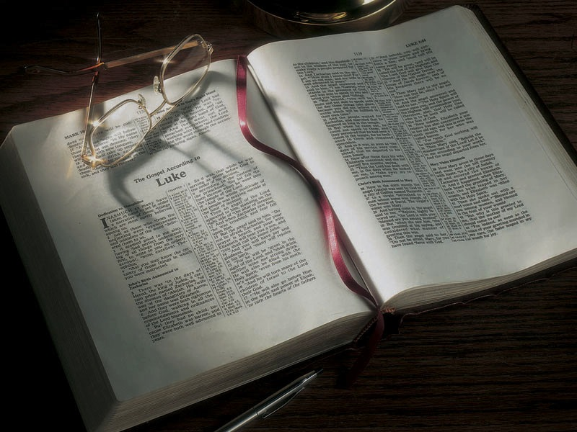

Slide 2
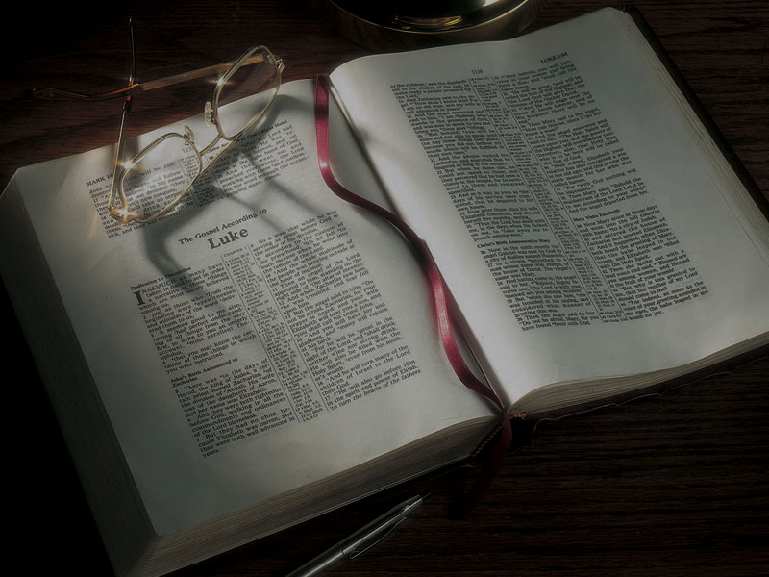
The Gospels
Jesus Heals Peter’s Mother-in-Law, Tours Galilee, Heals a Leper

Slide 3
Mark 1:29-34
29 Now as soon as they had come out of the synagogue, they entered the house of Simon and Andrew, with James and John.
30 But Simon’s wife’s mother lay sick with a fever, and they told Him about her at once.
31 So He came and took her by the hand and lifted her up, and immediately the fever left her. And she served them.

Slide 4
Mark 1:29-34
32 At evening, when the sun had set, they brought to Him all who were sick and those who were demon-possessed.
33 And the whole city was gathered together at the door.
34 Then He healed many who were sick with various diseases, and cast out many demons; and He did not allow the demons to speak, because they knew Him.

Slide 5
Luke 10:13-15
13 “Woe to you, Chorazin! Woe to you, Bethsaida! For if the mighty works which were done in you had been done in Tyre and Sidon, they would have repented long ago, sitting in sackcloth and ashes.
14 “But it will be more tolerable for Tyre and Sidon at the judgment than for you.
15 “And you, Capernaum, who are exalted to heaven, will be brought down to Hades.

Slide 6
Matthew 8:16-17
16 When evening had come, they brought to Him many who were demon-possessed. And He cast out the spirits with a word, and healed all who were sick,
17 that it might be fulfilled which was spoken by Isaiah the prophet, saying: “He Himself took our infirmities And bore our sicknesses.”

Slide 7
Isaiah 53:4-5
4 Surely He has borne our griefs and carried our sorrows; yet we esteemed Him stricken, smitten by God, and afflicted.
5 But He was wounded for our transgressions, He was bruised for our iniquities; the chastisement for our peace was upon Him, and by His stripes we are healed.

Slide 8
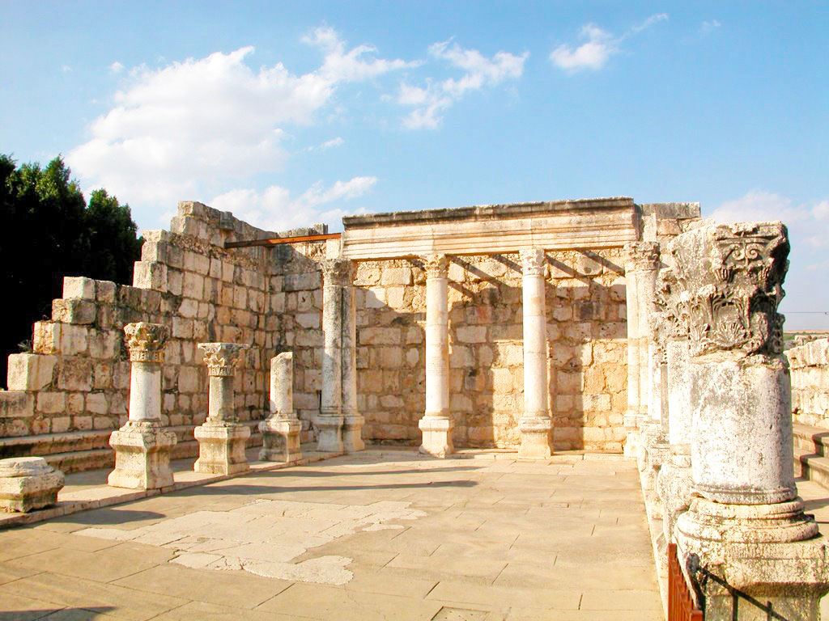

Slide 9
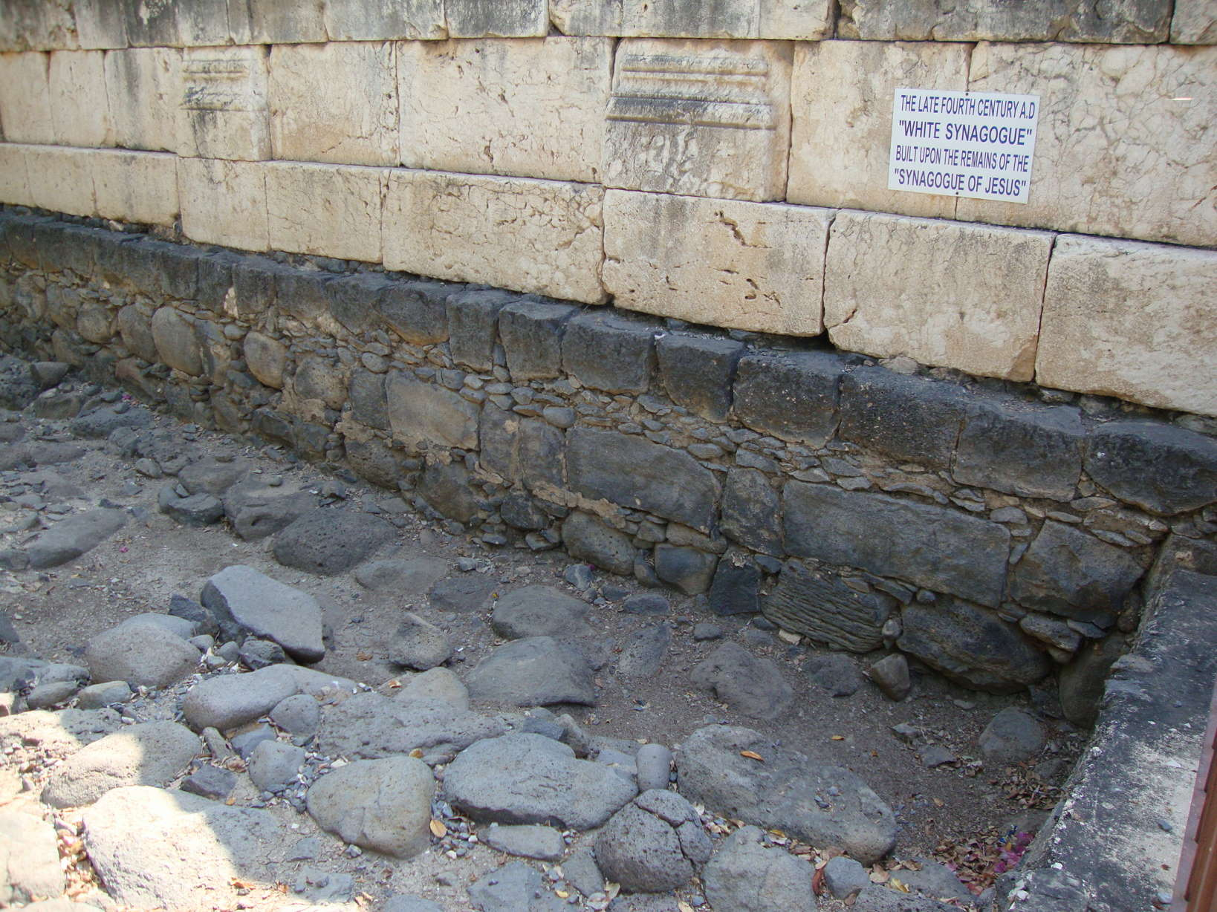

Slide 10
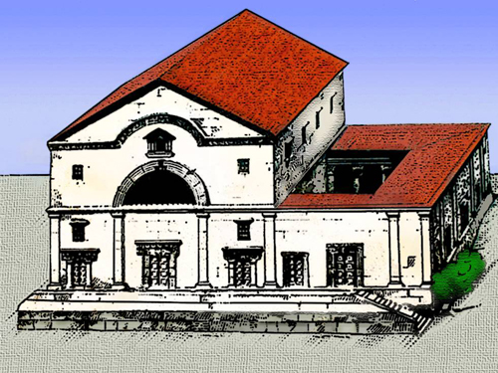

Slide 11
Mark 1:29-34
29 Now as soon as they had come out of the synagogue, they entered the house of Simon and Andrew, with James and John.
30 But Simon’s wife’s mother lay sick with a fever, and they told Him about her at once.
31 So He came and took her by the hand and lifted her up, and immediately the fever left her. And she served them.

Slide 12
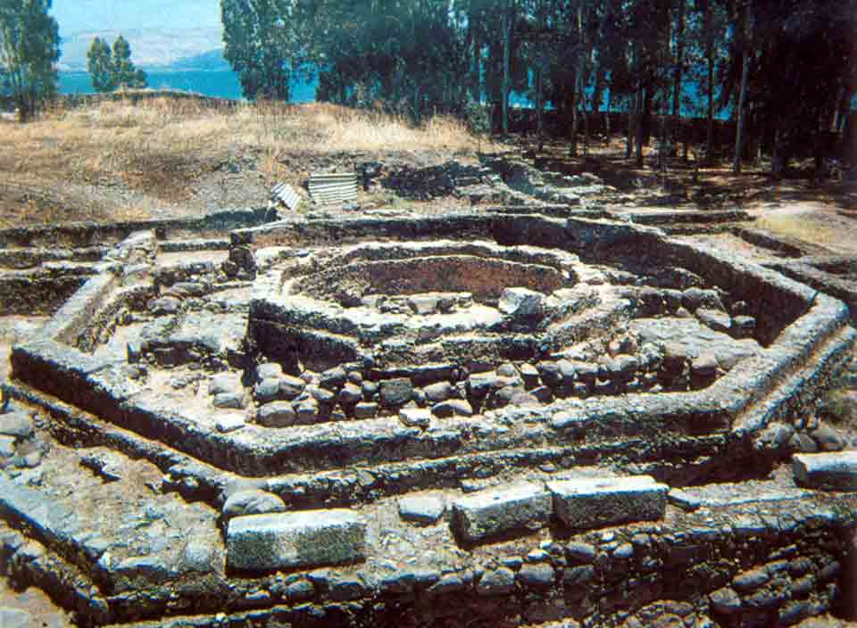

Slide 13
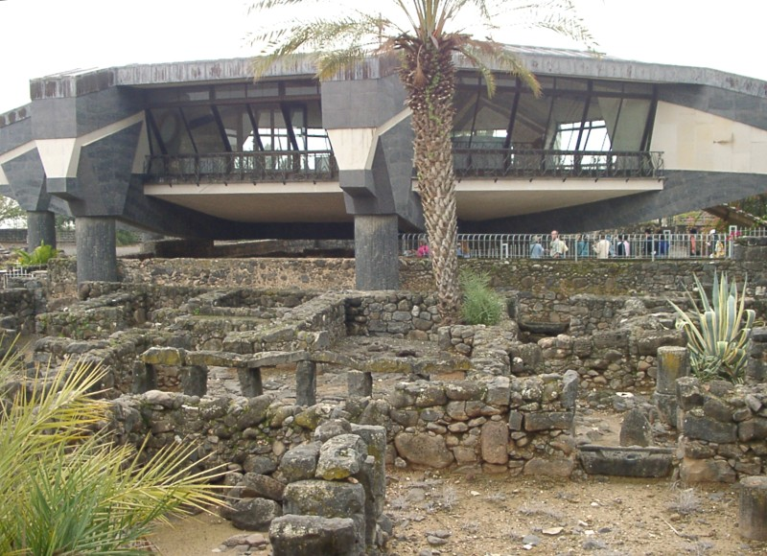

Slide 14
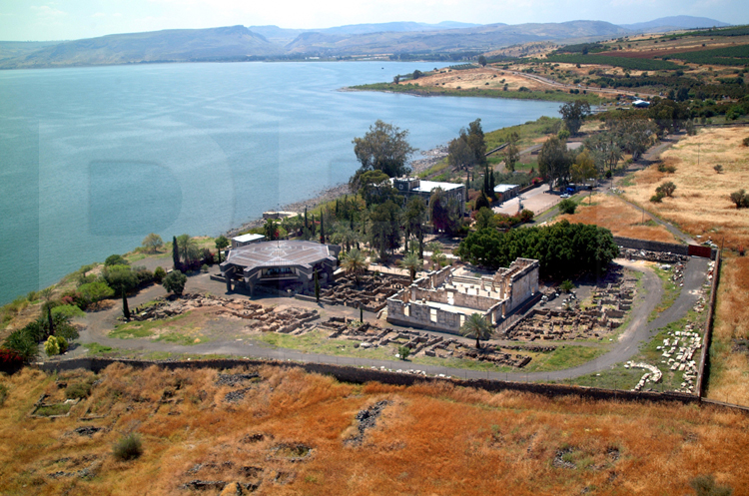

Slide 15
Mark 1:35-39
35 Now in the morning, having risen a long while before daylight, He went out and departed to a solitary place; and there He prayed.
36 And Simon and those who were with Him searched for Him.
37 When they found Him, they said to Him, “Everyone is looking for You.”

Slide 16
Mark 1:35-39
38 But He said to them, “Let us go into the next towns, that I may preach there also, because for this purpose I have come forth.”
39 And He was preaching in their synagogues throughout all Galilee, and casting out demons.

Slide 17
Matthew 4:23-25
23 And Jesus went about all Galilee, teaching in their synagogues, preaching the gospel of the kingdom, and healing all kinds of sickness and all kinds of disease among the people.
24 Then His fame went throughout all Syria; and they brought to Him all sick people who were afflicted with various diseases and torments, and those who were demon-possessed, epileptics, and paralytics; and He healed them.

Slide 18
Matthew 4:23-25
25 Great multitudes followed Him—from Galilee, and from Decapolis, Jerusalem, Judea, and beyond the Jordan.

Slide 19
Matthew 4:23-25
25 Great multitudes followed Him—from Galilee, and from Decapolis, Jerusalem, Judea, and beyond the Jordan.

Slide 20
Leviticus 13:1-3
1 The LORD said to Moses and Aaron,
2 “When anyone has a swelling or a rash or a bright spot on his skin that may become an infectious skin disease, he must be brought to Aaron the priest or to one of his sons who is a priest.
3 The priest is to examine the sore on his skin, and if the hair in the sore has turned white and the sore appears to be more than skin deep, it is an infectious skin disease. When the priest examines him, he shall pronounce him ceremonially unclean.

Slide 21
Leviticus 13:45-46
45 “The person with such an infectious disease must wear torn clothes, let his hair be unkempt, cover the lower part of his face and cry out, ‘Unclean! Unclean!’
46 As long as he has the infection he remains unclean. He must live alone; he must live outside the camp.

Slide 22
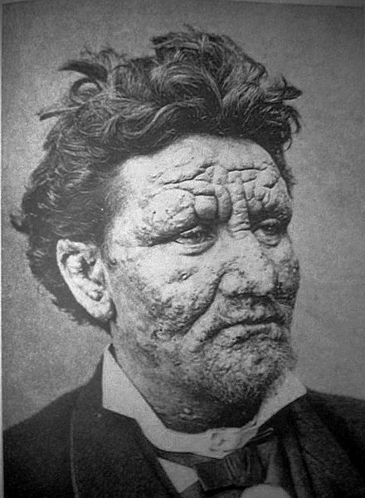

Slide 23
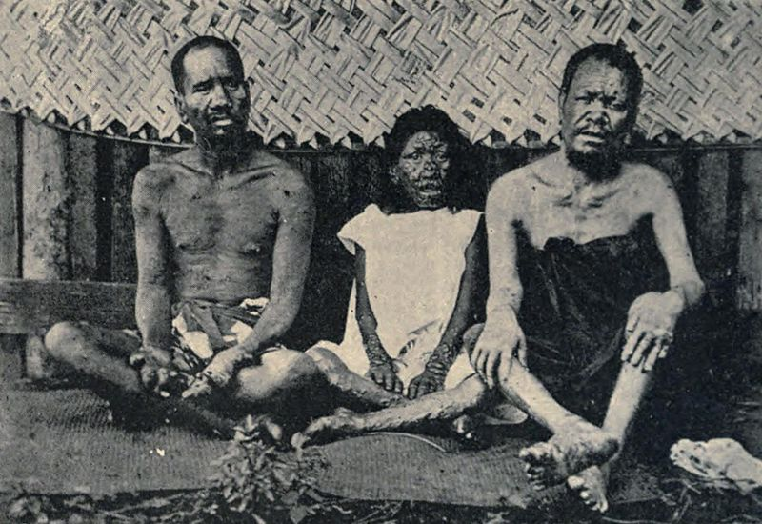

Slide 24
Mark 1:40-45
40 Now a leper came to Him, imploring Him, kneeling down to Him and saying to Him, “If You are willing, You can make me clean.”
41 Then Jesus, moved with compassion, stretched out His hand and touched him, and said to him, “I am willing; be cleansed.”
42 As soon as He had spoken, immediately the leprosy left him, and he was cleansed.

Slide 25
Mark 1:40-45
43 And He strictly warned him and sent him away at once,
44 and said to him, “See that you say nothing to anyone; but go your way, show yourself to the priest, and offer for your cleansing those things which Moses commanded, as a testimony to them.”
45 However, he went out and began to proclaim it freely, and to spread the matter, so that Jesus could no longer openly enter the city, but was outside in deserted places; and they came to Him from every direction.

Slide 26
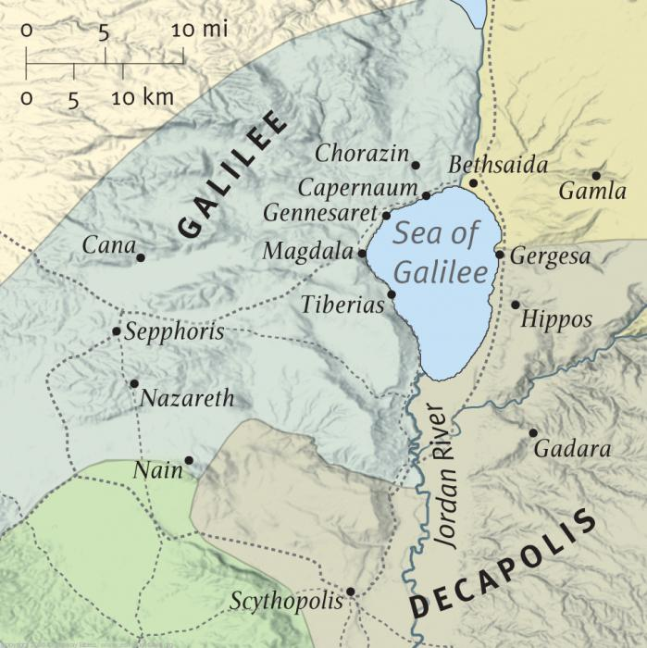
Religious Jews
Zealots
Herodians
Pagans
Samaritans

Slide 27
John 6:14-15
14 Then those men, when they had seen the sign that Jesus did, said, “This is truly the Prophet who is to come into the world.”
15 Therefore when Jesus perceived that they were about to come and take Him by force to make Him king, He departed again to the mountain by Himself alone.

Slide 28
Mark 1:40-45
43 And He strictly warned him and sent him away at once,
44 and said to him, “See that you say nothing to anyone; but go your way, show yourself to the priest, and offer for your cleansing those things which Moses commanded, as a testimony to them.”
45 However, he went out and began to proclaim it freely, and to spread the matter, so that Jesus could no longer openly enter the city, but was outside in deserted places; and they came to Him from every direction.

Slide 29
Acts 1:1
1 The former account I made, O Theophilus, of all that Jesus began both to do and teach . . .

Slide 30
Lessons/takeaways for us:

Slide 31
Lessons/takeaways for us:
Jesus is our Savior, but He is also our Rescuer.

Slide 32
Lessons/takeaways for us:
Jesus is our Savior, but He is also our Rescuer.
Jesus never turns people away.

Slide 33
Lessons/takeaways for us:
Jesus is our Savior, but He is also our Rescuer.
Jesus never turns people away.
Jesus needed quiet, alone time to spend with His heavenly Father—and so do we.

Slide 34
Lessons/takeaways for us:
Jesus is our Savior, but He is also our Rescuer.
Jesus never turns people away.
Jesus needed quiet, alone time to spend with His heavenly Father—and so do we.
Sometimes God is unpredictable when it comes to our expectations.

Slide 35
Lessons/takeaways for us:
Jesus is our Savior, but He is also our Rescuer.
Jesus never turns people away.
Jesus needed quiet, alone time to spend with His heavenly Father—and so do we.
Sometimes God is unpredictable when it comes to our expectations.
Before our calling, we were like the leper—covered in our sins and cut off from God.

Slide 36
Ephesians 2:12 (NIV)
12 Remember that at that time you were separate from Christ, excluded from citizenship in Israel and foreigners to the covenants of the promise, without hope and without God in the world.

Slide 37
Lessons/takeaways for us:
Jesus is our Savior, but He is also our Rescuer.
Jesus never turns people away.
Jesus needed quiet, alone time to spend with His heavenly Father—and so do we.
Sometimes God is unpredictable when it comes to our expectations.
Before our calling, we were like the leper—covered in our sins and cut off from God.
God responds to those who want to be cleansed and seek Him to be cleansed.

Slide 38
Lessons/takeaways for us:
Jesus is our Savior, but He is also our Rescuer.
Jesus never turns people away.
Jesus needed quiet, alone time to spend with His heavenly Father—and so do we.
Sometimes God is unpredictable when it comes to our expectations.
Before our calling, we were like the leper—covered in our sins and cut off from God.
God responds to those who want to be cleansed and seek Him to be cleansed.
God uses “do and teach” with us.

Slide 41
Four key questions for us:
What does this teach us about the nature and character of God?
What does this teach us about the way God interacts with His people and mankind?
What does this mean for your relationship with God the Father and Jesus Christ?
What does this teach us about Satan, the adversary of God and mankind?

Slide 42
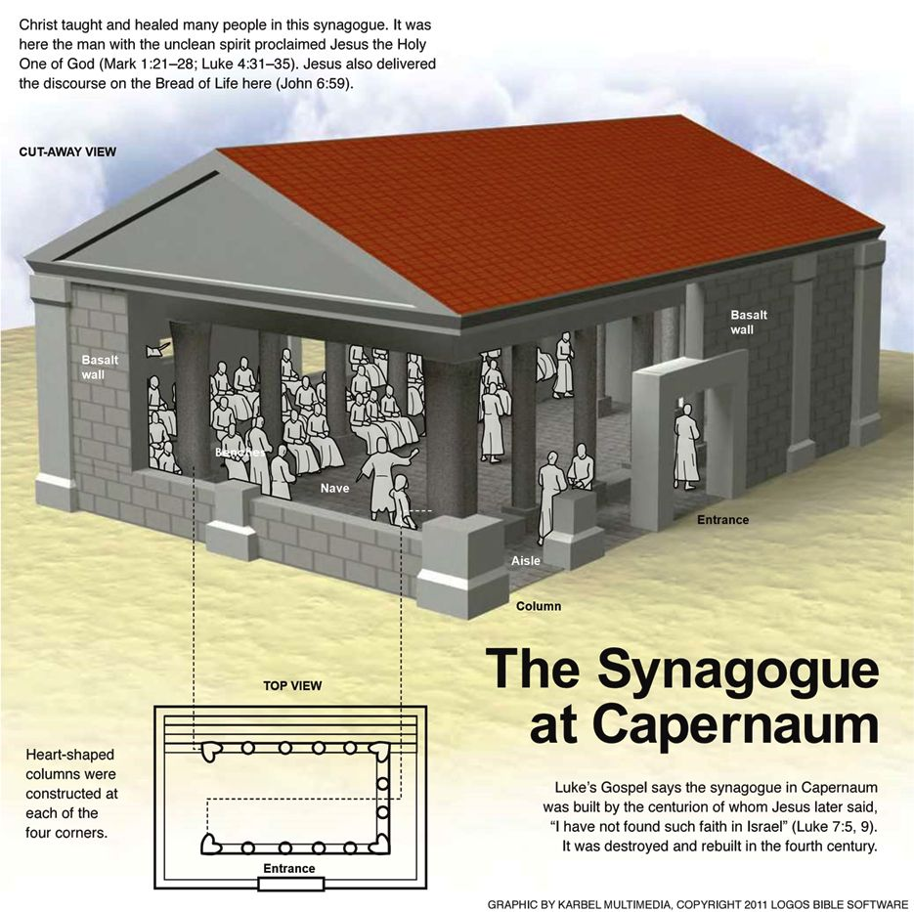

Slide 43
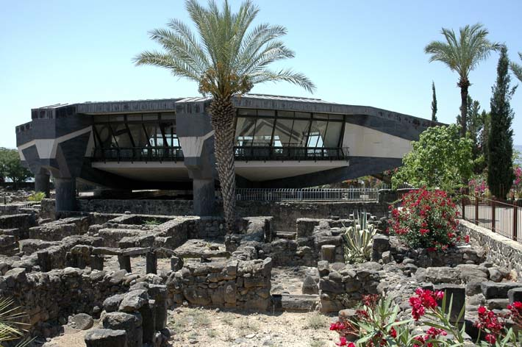

Slide 44
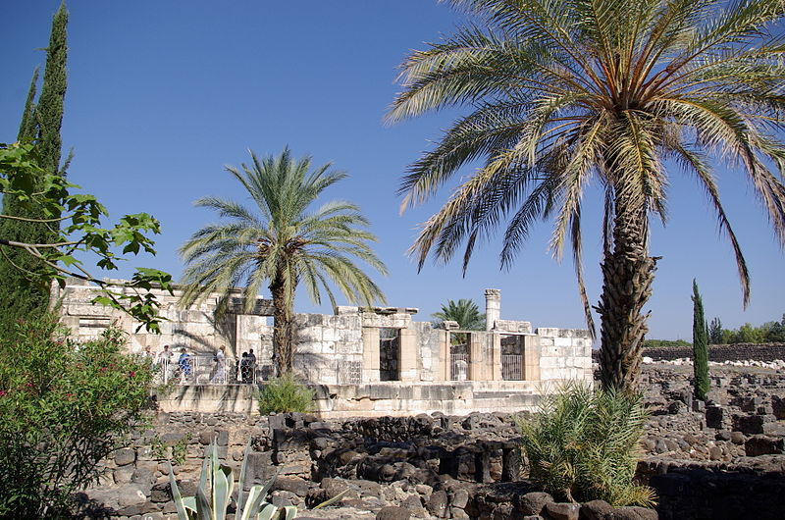

Slide 45
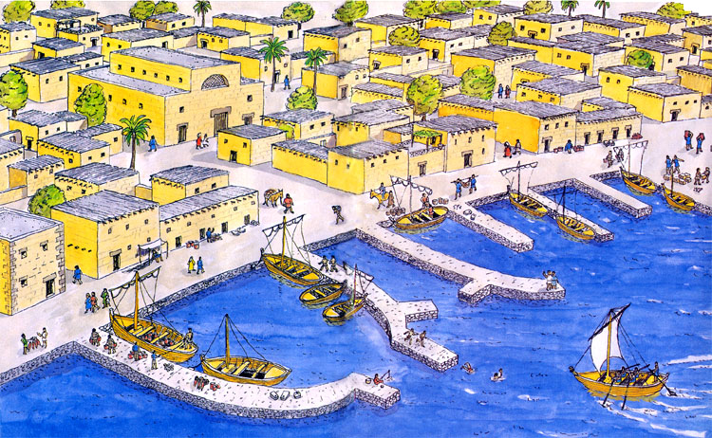

Slide 46
